Slide 1
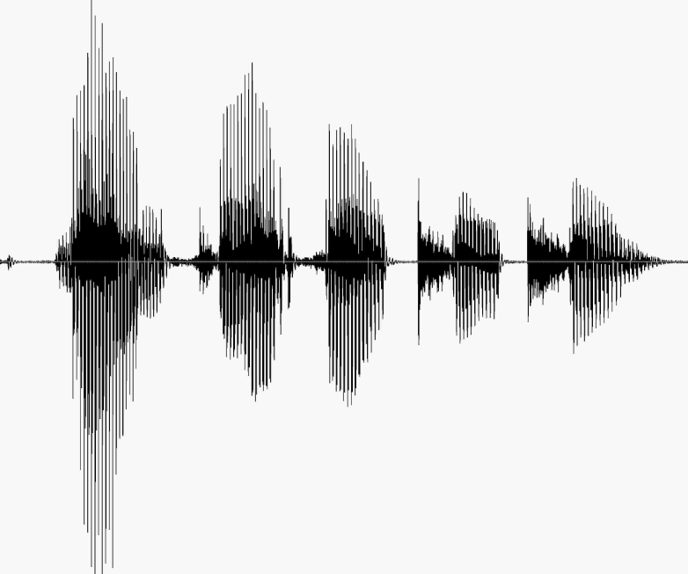
CS 224S / LINGUIST 285 Spoken Language Processing
Andrew Maas
Stanford University
Lecture 1: Introduction, ARPAbet, Articulatory Phonetics
Original slides by Dan Jurafsky

Slide 2
April 3, Week 1
Course introduction
Course topics overview
Speech recognition
Dialog / conversational agents
Speech synthesis (Text to speech)
Affect extraction
Very brief history
Articulatory Phonetics
Course Logistics
ARPAbet transcription

Slide 3
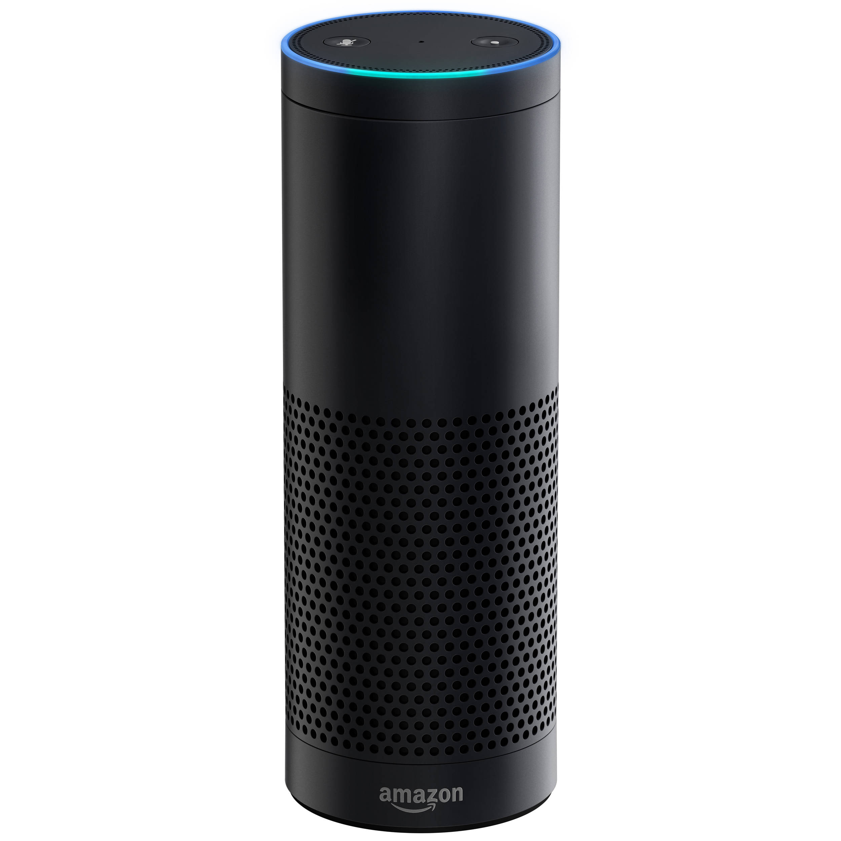
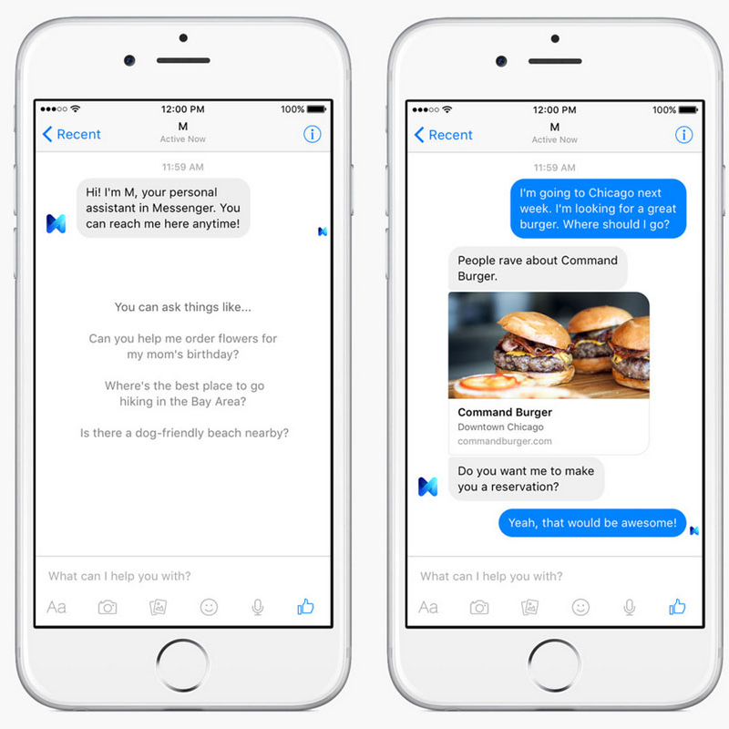
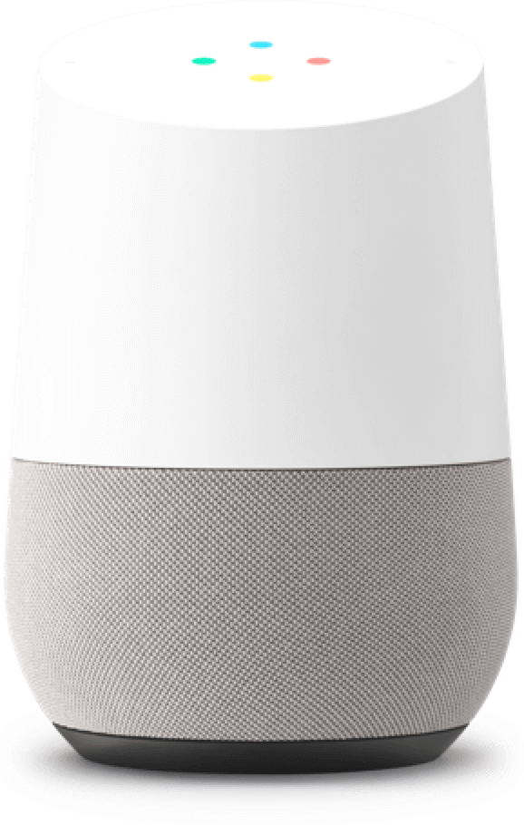
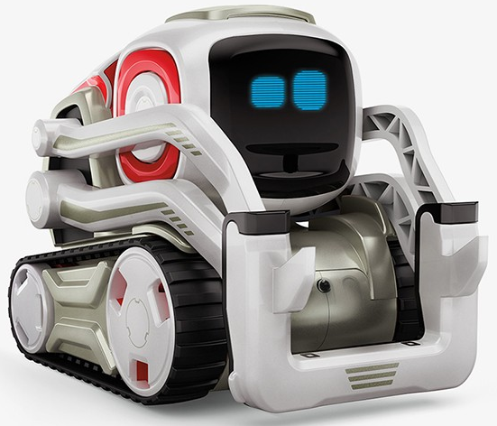
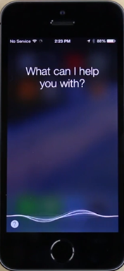
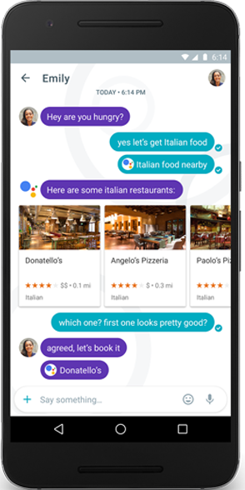
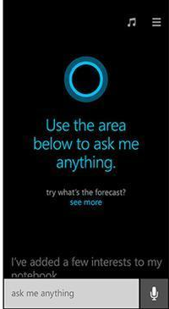
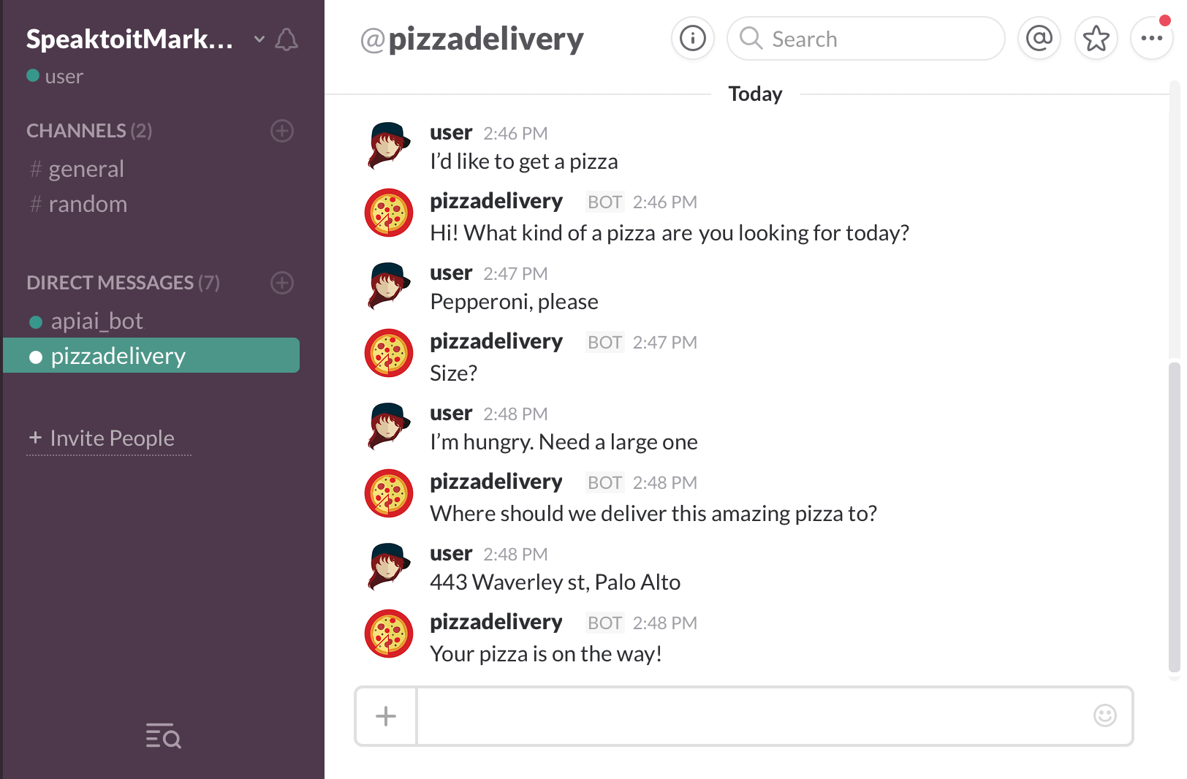
An exciting time for spoken language processing
Amazon Echo
2015
Google Home
2016
Anki Cozmo
2016
Facebook M
2015
Apple
Siri
2011
Google
Assistant
2016
Microsoft Cortana
2014
Slack Bot API
2015

Slide 4
LVCSR
Large Vocabulary Continuous Speech Recognition
~64,000 words
Speaker independent (vs. speaker-dependent)
Continuous speech (vs isolated-word)

Slide 5
Current error rates
Ballpark numbers; exact numbers depend very much on the specific corpus
Task | Vocabulary | Word Error Rate %
Digits | 11 | 0.5
WSJ read speech | 5K | 1
WSJ read speech | 20K | 1
Broadcast news | 64,000+ | 4
Conversational Telephone | 64,000+ | 6

Slide 6

Why is conversational speech harder?
A piece of an utterance without context
The same utterance with more context

Slide 7
HSR versus ASR
Task | Vocab | ASR | Hum SR
Continuous digits | 11 | .5 | .009
WSJ 1995 clean | 5K | 3 | 0.9
WSJ 1995 w/noise | 5K | 9 | 1.1
SWBD 2004 | 65K | ~6 | 3-4?
Conclusions:
Gap increases with noisy speech
These numbers are rough, take with grain of salt
We are overfitting to the benchmark datasets

Slide 8
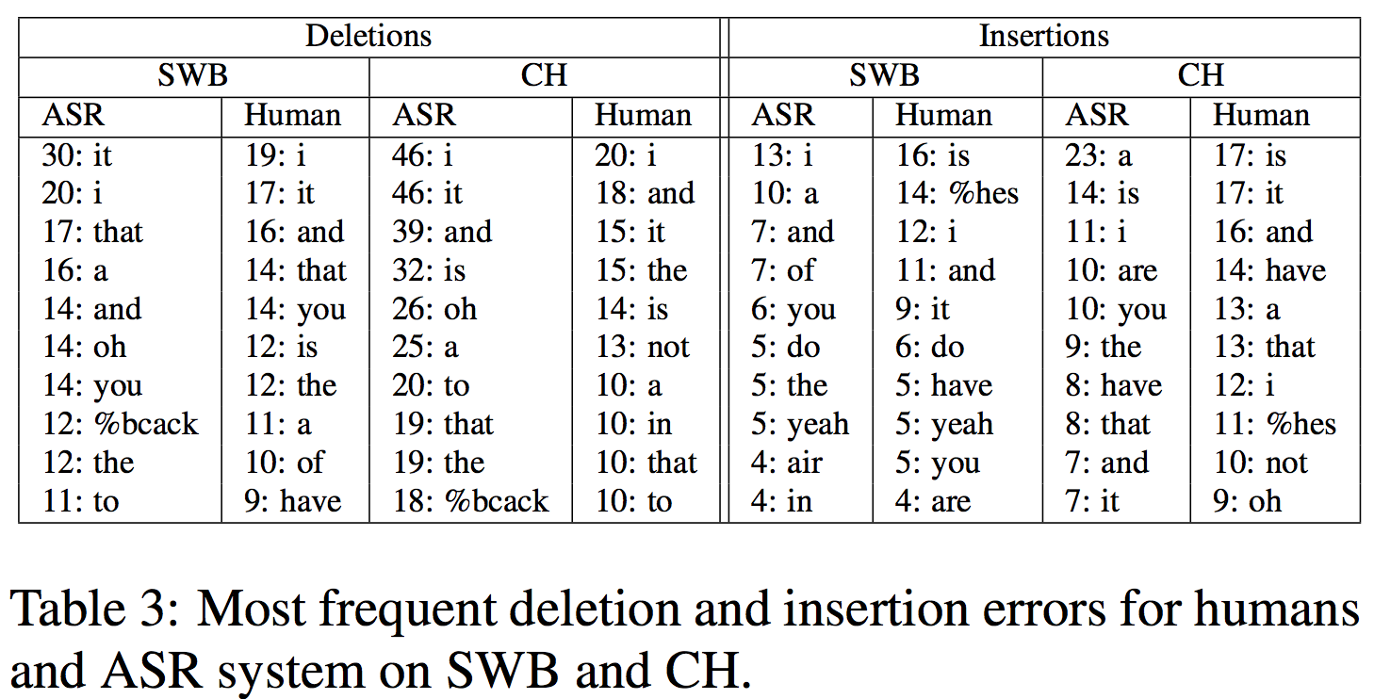
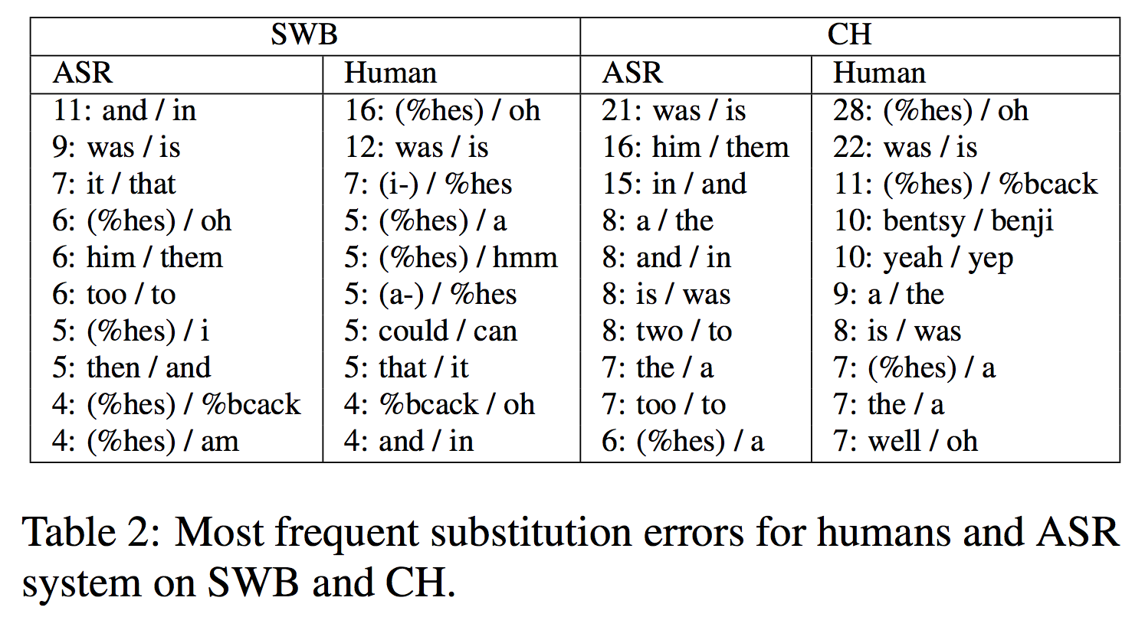
HSR versus ASR
(Saon et al, 2017)

Slide 9
Why accents are hard
A word by itself
The word in context

Slide 10
So is speech recognition solved? Why study it vs just use some API?
In the last ~5 years
Dramatic reduction in LVCSR error rates (16% to 6%)
Human level LVCSR performance on Switchboard
New class of recognizers (end to end neural network)
Understanding how ASR works enables better ASR-enabled systems
What types of errors are easy to correct?
How can a downstream system make use of uncertain outputs?
How much would building our own improve on an API?
Next generation of ASR challenges as systems go live on phones and in homes
Notes:
MSR paper on human level performance: https://arxiv.org/abs/1610.05256
Recent IBM results + comparison to humans: https://arxiv.org/abs/1703.02136

Slide 11
Speech Recognition Design Intuition
Build a statistical model of the speech-to-words process
Collect lots and lots of speech, and transcribe all the words.
Train the model on the labeled speech
Paradigm: Supervised Machine Learning + Search

Slide 12
Dialogue (= Conversational Agents)
Personal Assistants
Apple SIRI
Microsoft Cortana
Google Assitant
Design considerations
Synchronous or asynchronous tasks
Pure speech, pure text, UI hybrids
Functionality versus personality

Slide 13
Paradigms for Dialogue
POMDP
Partially-Observed Markov Decision Processes
Reinforcement Learning to learn what action to take
Asking a question or answering one are just actions
“Speech acts”
Simple regular expressions and slot filling
Pre-built frames
Calendar
Who
When
Where
Filled by hand-built rules
(“on (Mon|Tue|Wed…)”)

Slide 14
Paradigms for Dialogue
POMDP
Exciting Research
Implemented in no commercial systems
Simple regular expressions and slot filling
State of the art used most systems
Reusing new search engine technology
Intent recognition / semantic parsing
Neural network chatbots
Recent research, not really dialog yet

Slide 15
Extraction of Social Meaning from Speech
Detection of student uncertainty in tutoring
Forbes-Riley et al. (2008)
Emotion detection (annoyance)
Ang et al. (2002)
Detection of deception
Newman et al. (2003)
Detection of charisma
Rosenberg and Hirschberg (2005)
Speaker stress, trauma
Rude et al. (2004), Pennebaker and Lay (2002)

Slide 16
Conversational style
Given speech and text from a conversation
Can we tell if a speaker is
Awkward?
Flirtatious?
Friendly?
Dataset:
1000 4-minute “speed-dates”
Each subject rated their partner for these styles
The following segment has been lightly signal-processed:

Slide 17
Speaker Recognition tasks
Speaker Recognition
Speaker Verification (Speaker Detection)
Is this speech sample from a particular speaker
Is that Jane?
Speaker Identification
Which of these speakers does this sample come from?
Who is that?
Related tasks: Gender ID, Language ID
Is this a woman or a man?
Speaker Diarization
Segmenting a dialogue or multiparty conversation
Who spoke when?

Slide 18
Applications of Speaker Recognition
Speaker Recognition:
Speaker verification (binary decision)
Voice password
Telephone assistant
Speaker identification (one of N)
Criminal investigation
Diarization
Transcribing meetings

Slide 19
TTS (= Text-to-Speech) (= Speech Synthesis)
Produce speech from a text input
Applications:
Personal Assistants
Apple SIRI
Microsoft Cortana
Google Assistant
Games
Airport Announcements

Slide 20
TTS Overview
Main Commercial Algorithm
Google TTS
Collect lots of speech (5-50 hours) from one speaker, transcribe very carefully, all the syllables and phones and whatnot
To synthesize a sentence, patch together syllables and phones from the training data.
Parametric synthesis shows recent gains
First end to end neural systems in 2016

Slide 21
History: foundational insights 1900s-1950s
Automaton:
Markov 1911
Turing 1936
McCulloch-Pitts neuron (1943)
http://marr.bsee.swin.edu.au/~dtl/het704/lecture10/ann/node1.html
http://diwww.epfl.ch/mantra/tutorial/english/mcpits/html/
Shannon (1948) link between automata and Markov models
Human speech processing
Fletcher at Bell Labs (1920’s)
Probabilistic/Information-theoretic models
Shannon (1948)

Slide 22
Speech synthesis is old!
Pictures and some text from Hartmut Traunmüller’s web site:
http://www.ling.su.se/staff/hartmut/kemplne.htm
Von Kempeln 1780 b. Bratislava 1734 d. Vienna 1804
Leather resonator manipulated by the operator to try and copy vocal tract configuration during sonorants (vowels, glides, nasals)
Bellows provided air stream, counterweight provided inhalation
Vibrating reed produced periodic pressure wave

Slide 23
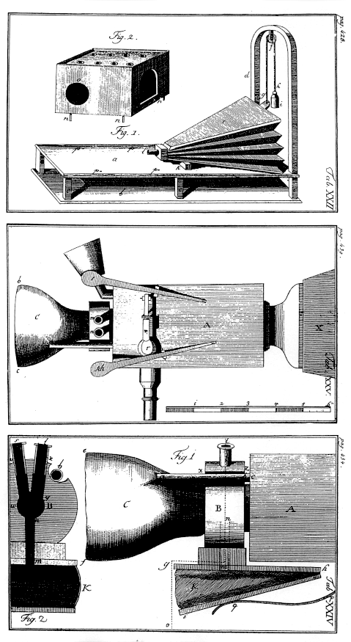
Von Kempelen:
Small whistles controlled consonants
Rubber mouth and nose; nose had to be covered with two fingers for non-nasals
Unvoiced sounds: mouth covered, auxiliary bellows driven by string provides puff of air
From Traunmüller’s web site

Slide 24
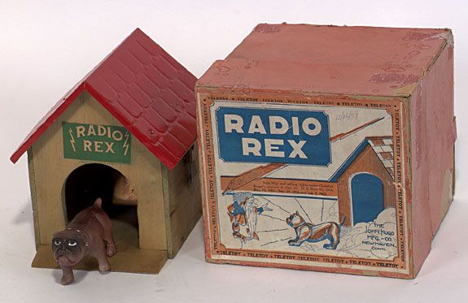
History: Early Recognition
1920’s Radio Rex
Celluloid dog with iron base held within house by electromagnet against force of spring
Current to magnet flowed through bridge which was sensitive to energy at 500 Hz
500 Hz energy caused bridge to vibrate, interrupting current, making dog spring forward
The sound “e” (ARPAbet [eh]) in Rex has 500 Hz component

Slide 25
History: early ASR systems
1950’s: Early Speech recognizers
1952: Bell Labs single-speaker digit recognizer
Measured energy from two bands (formants)
Built with analog electrical components
2% error rate for single speaker, isolated digits
1958: Dudley built classifier that used continuous spectrum rather than just formants
1959: Denes ASR combining grammar and acoustic probability

Slide 26
History: early ASR systems
1960’s
FFT - Fast Fourier transform (Cooley and Tukey 1965)
LPC - linear prediction (1968)
1969 John Pierce letter “Whither Speech Recognition?”
Random tuning of parameters,
Lack of scientific rigor, no evaluation metrics
Need to rely on higher level knowledge

Slide 27
ASR: 1970’s and 1980’s
Hidden Markov Model 1972
Independent application of Baker (CMU) and Jelinek/Bahl/Mercer lab (IBM) following work of Baum and colleagues at IDA
ARPA project 1971-1976
5-year speech understanding project: 1000 word vocab, continous speech, multi-speaker
SDC, CMU, BBN
Only 1 CMU system achieved goal
1980’s+
Annual ARPA “Bakeoffs”
Large corpus collection
TIMIT
Resource Management
Wall Street Journal

Slide 28
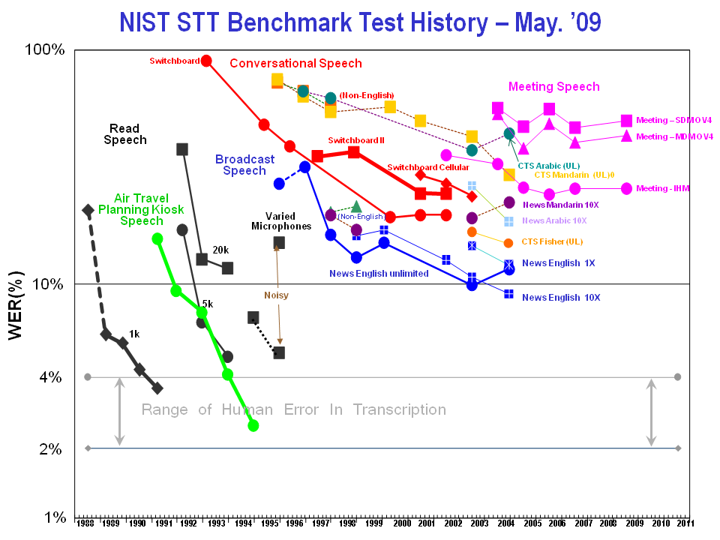
Notes:
http://itl.nist.gov/iad/mig/publications/ASRhistory/index.html

Slide 29
Course Logistics

Slide 30
Course Logistics
http://www.stanford.edu/class/cs224s
Homeworks released and due on Wednesdays
Gradescope for homework submission
Piazza for questions. Email staff only for personal/confidential questions
Project poster session tentatively June 7 (during class time)

Slide 31
Admin: Requirements and Grading
Readings:
Selected chapters from
Jurafsky & Martin. Speech and Language Processing.
Will mix chapters from 2nd and in progress 3rd editions
A few conference and journal papers
Grading
Homework: 40%
4 assignments. Will use Python, Tensorflow, and command line tools
Course Project: 50%
Group projects of 3 people
Participation: 10%

Slide 32
Necessary Background
Foundations of machine learning and natural language processing
CS 124, CS 224N, CS 229, or equivalent experience
Mathematical foundations of neural networks
Understand forward and back propagation in terms of equations
Proficiency in Python
Programming heavy homeworks will use Python and Tensorflow

